Slide 1
Advanced SDR Ham radios vhf, UHF, Microwaves
John Petrich, W7FU
MUD 2017
October 27, 2017

Slide 2
GOAL
Inspire you to approach microwave station building in a different way

Slide 3
Presentation Outline
Review advanced SDR Microwave hardware and ‘ham friendly’ DSP software
Ham Microwave rigs: examples and ideas
Note: heavy emphasis on homebrewing

Slide 4
What’s ‘Advanced’ about modern SDR’s?
SDR digital hardware integrated with RFIC transceivers, to provide direct conversion for VHF/Microwave frequencies
- developed for cell phone industry
- optimized for VHF/lower Microwave use
- low noise, high S/N ratio, RF linearity, frequency stability, and dynamic range
‘Ham Friendly’ DSP software tools readily available to hobbyists

Slide 5
SDR: The New Normal?
Wide design flexibility in terms of modulation bandwidth and frequency coverage
High performance signal processing
Simplified system design using a wideband
direct conversion SDR

Slide 6
Advanced SDR Hardware
Development lab, test and measurement, education oriented, and not cheap
Easily repurposed to ham use
Assumes considerable self-learning based on first principles

Slide 7
Advanced SDR Hardware Choices
Ettus Research USRP
www.Ettus.com/products
Nuand/Blade RF
www.Nuand.com
Hack RF
http://www.greatscottgadgets.com/
Lime SDR
www.limemicro.com/products/software-defined-radio/

Slide 8
Advanced SDR Hardware
Hardware Example
Ettus Research USRP, B200/210 SDR transceiver
direct conversion from 50 MHz to 6 GHz
state of the art RF & baseband performance
low phase noise frequency synthesizers
optional external master clock
TX RF output >> +5 dBm
RX ~2+ dB NF
single board solution (6” x 4”) or (3.25” x 2”)

Slide 9
Advanced SDR Hardware

Slide 10
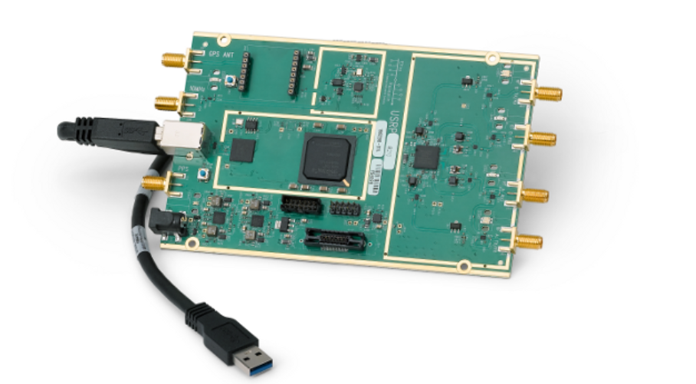
Advanced SDR Hardware
Ettus USRP B210 SDR Transceiver

Slide 11
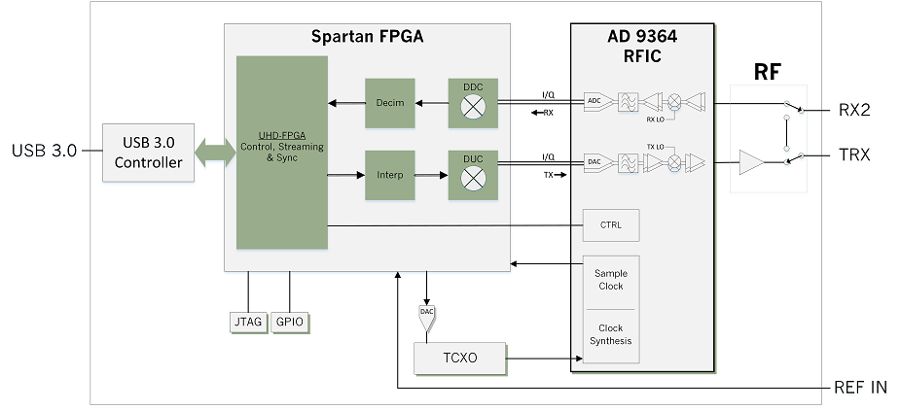
Advanced SDR Hardware
Ettus USRP B200 SDR Transceiver

Slide 12
Native Performance Examples
Transmitter Spurious Output, Phase Noise, and Linearity

Slide 13
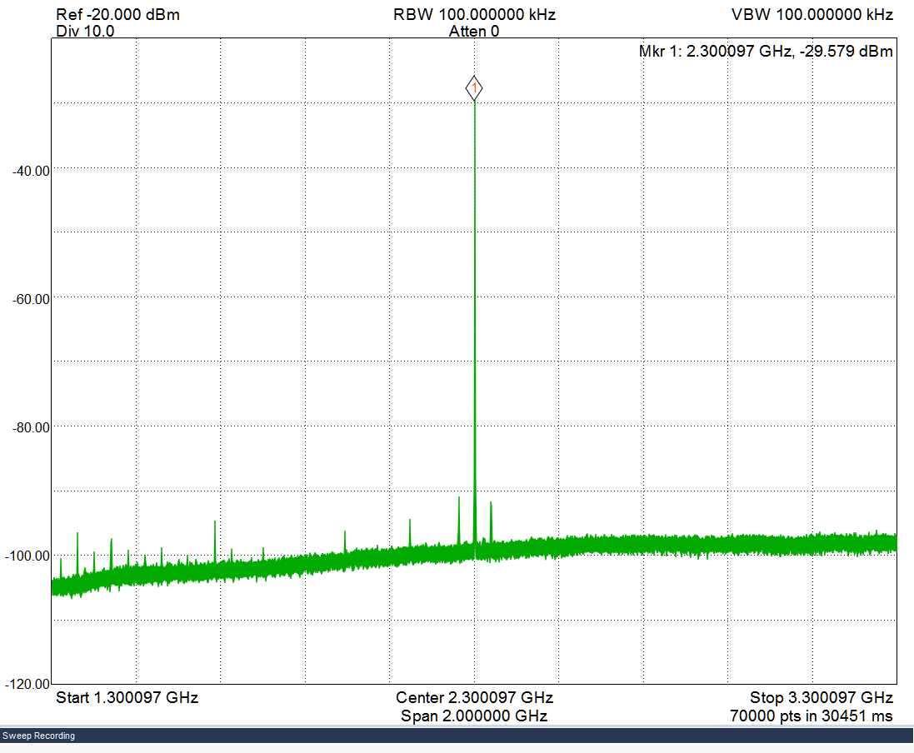
Microwave Spectral Purity
Wideband Transmit Spectrum @ 2.3 GHz

Slide 14
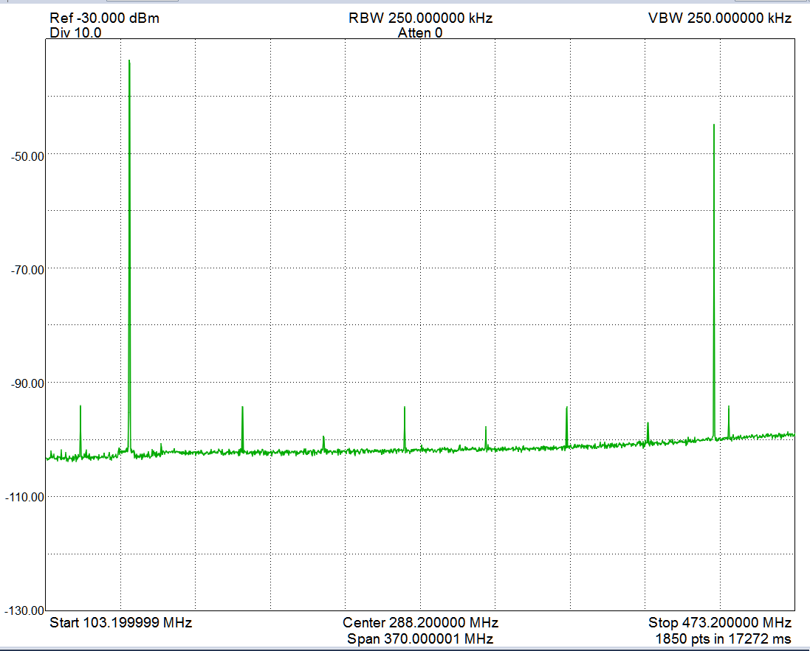
VHF Harmonic Analysis
Harmonic Analysis @ 144 MHz (typical)

Slide 15
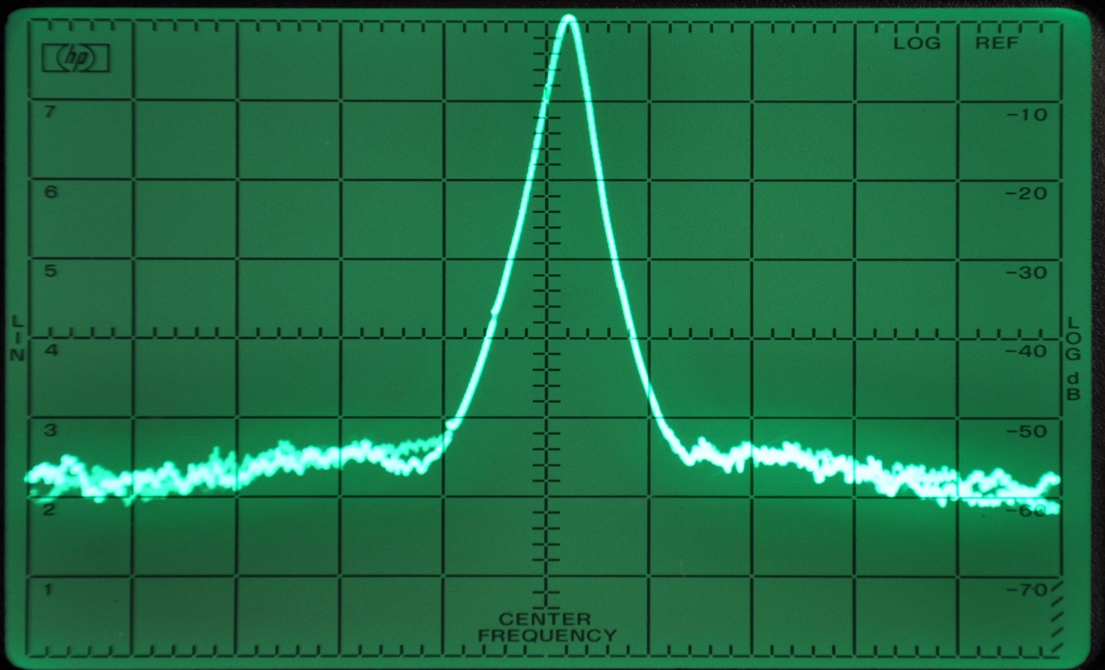
Microwave Phase Noise
Phase Noise: 5.8 GHz @10 kHz RBW

Slide 16
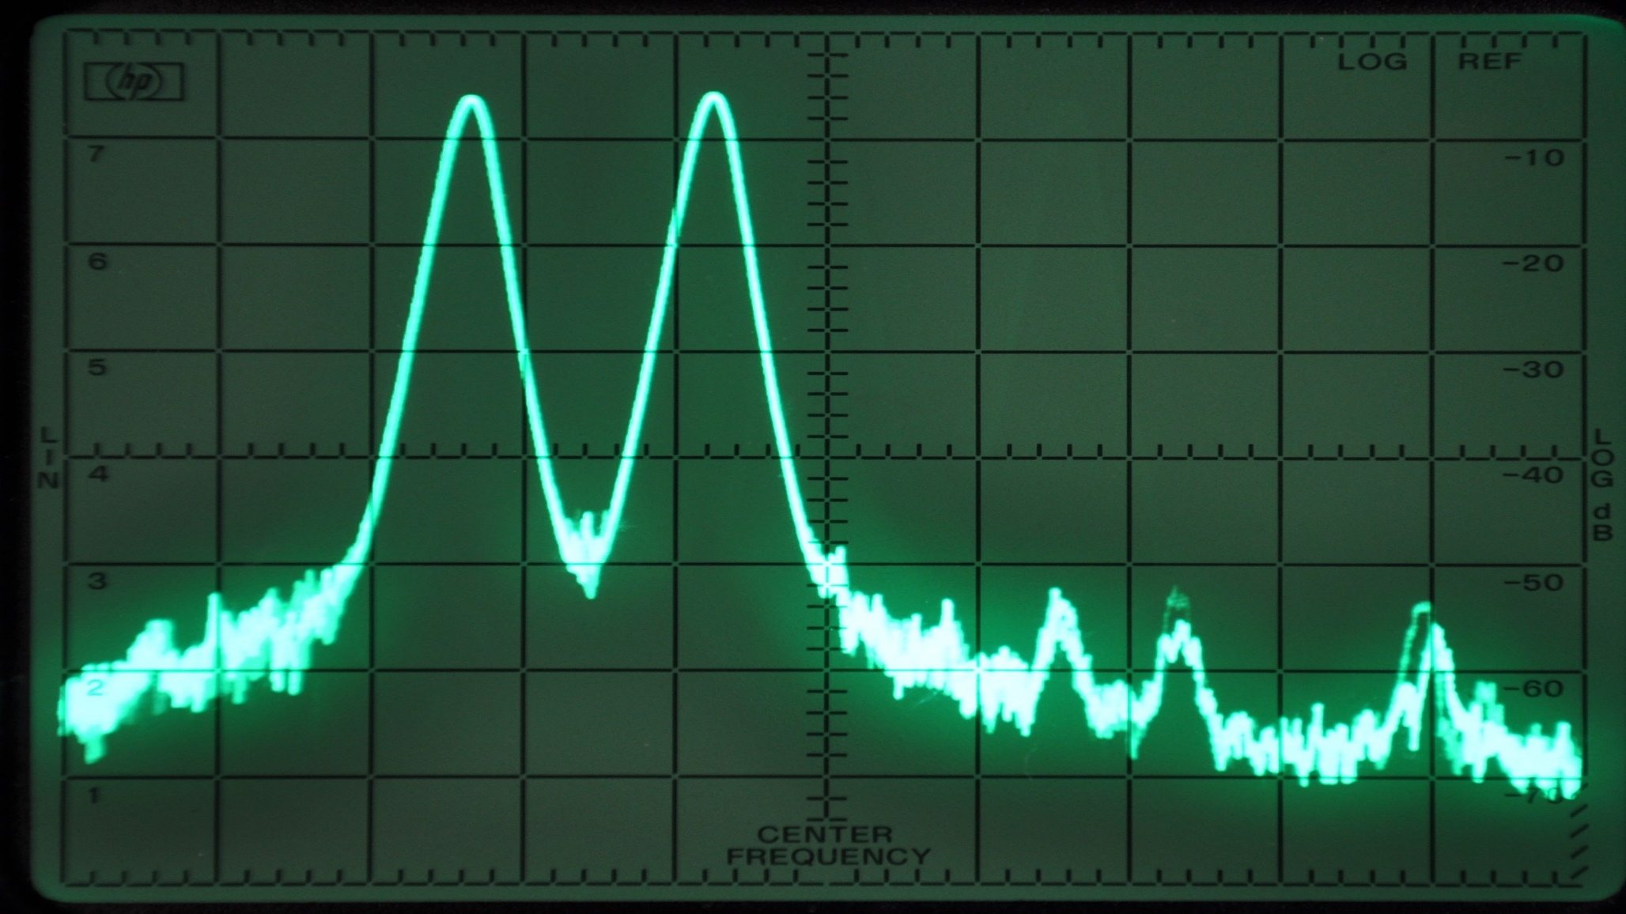
Microwave Transmit Linearity
Two Tone LSB: 5.8 GHz @10 kHz RBW

Slide 17
‘Advanced’ DSP Software
GNU Radio: “Ham Friendly DSP”
Open source DSP library: supported in Linux, Windows, OSX, operating systems
Graphical DSP authoring simplified
Optimized for ‘real time’ signal processing
(VOLK, C++ API)
Supports transmit and receive DSP

Slide 18
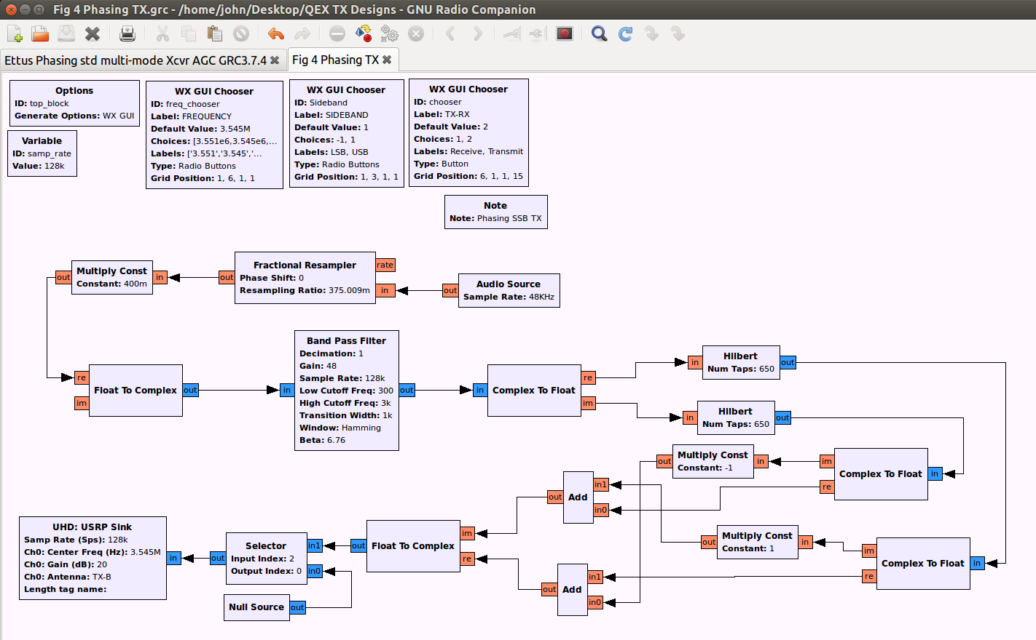
GNU Radio DSP Flow Graph
SSB Phasing Transmitter DSP

Slide 19
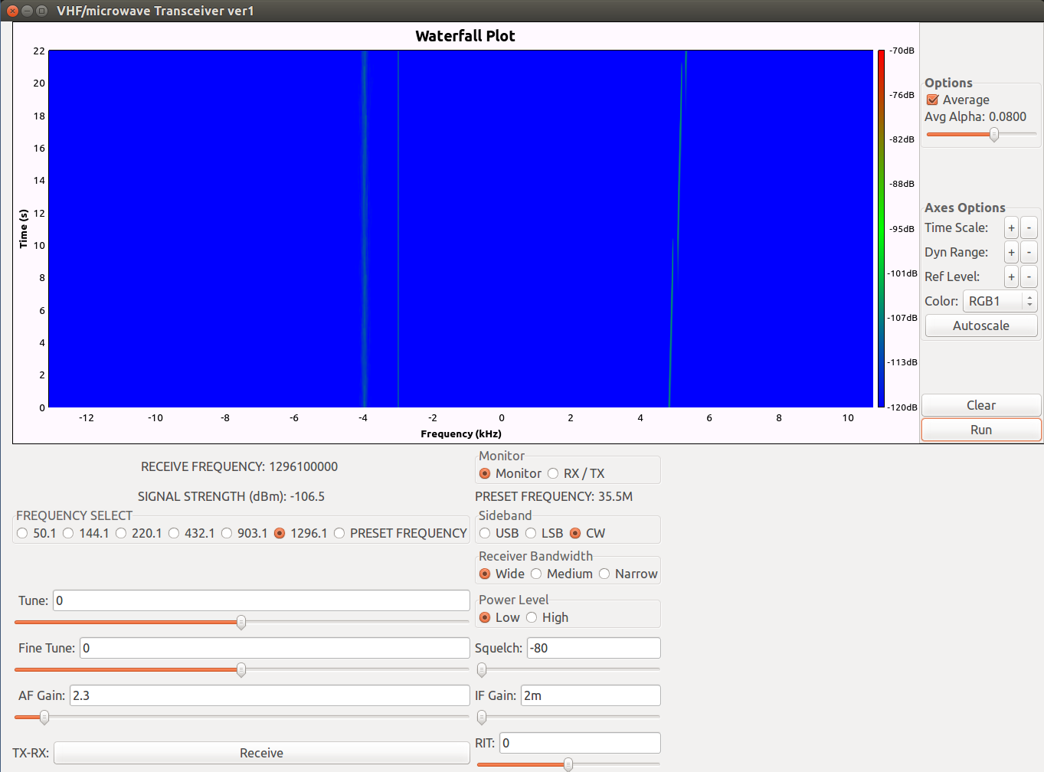
GNU Radio DSP GUI

Slide 20
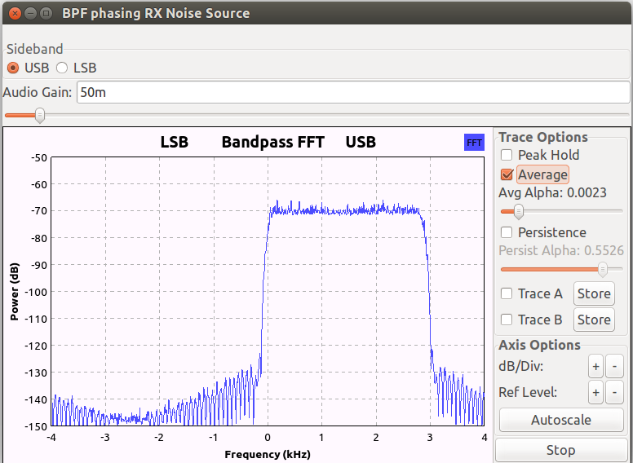
Receiver Bandwidth Spectrum
Receiver Bandwidth 3 kHz

Slide 21
Advanced’ DSP Software
SoDa Radio: Custom Ham Software
Matt Reilly, KB1VC
Custom ham oriented DSP software
Open source, free download
Linux OS
All mode, Transmit and Receive DSP
Written for the full Ettus USRP product line: UHD

Slide 22
‘Advanced’ DSP Software
GNU Radio
GNU Radio home page: https://wiki.gnuradio.org/
Ham Friendly DSP:
https://w7fu.com/
SoDa Radio
https://kb1vc.github.io/SoDaRadio/

Slide 23
SDR Examples: What you can do with this stuff
Test and Measurement
Signal Source: synthesized frequency
RF and IF Spectrum Analyzer: ~ 25 MHz instantaneous bandwidth, high sensitivity
Scaler Network Analyzer: point by point

Slide 24
SDR Examples: What you can do with this stuff
Microwave Radios
Direct Conversion radio architecture:
VHF and lower Microwave bands

Slide 25
Traditional Conversion to Microwaves
High performance HF transceiver
Outboard Linear Up-converter(s) per band
Custom per band RF ‘interface’
HF
Transceiver Transceiver
Linear
Up-converter
Power Amplifier LNA Tx/Rx relay

Slide 26
Direct Conversion SDR Ham Microwave Radio System
High performance direct conversion SDR broadband transceiver
Custom per band RF PA and LNA
Microwave SDR Transceiver
Power Amplifier
LNA Tx / Rx relay
Signal

Slide 27
Direct Conversion SDR: VHF/UHF/Microwave
RFIC
(mixer)
VHF/UHF/uW Antenna
A/D Converter
(baseband)
signal
signal
D/A
Converter
Computer
DSP
FPGA
DSP
data
data
Etc..
baseband
analog
data

Slide 28
Direct Conversion SDR: VHF/UHF/Microwave

Slide 29
5.7 GHz SDR - Rover Station

Slide 30
SDR Examples: What you can do with this stuff
Microwave Radios
Double Conversion radio architecture: upper Microwave and mm Wave bands
Flexible IF choices: 50 MHz to 6 GHz
Any modulation including JT modes

Slide 31
Double Conversion SDR Traditional Architecture: VHF IF
Microwave Antenna
DBM
(mixer)
VHF IF frequency with SDR direct conversion to
baseband
signal
signal
D/A
Converter
Computer
DSP
A/D Converter
(baseband)
data
data
baseband
analog
data
Etc..

Slide 32
24 GHz Transverter: 144 MHz SDR IF

Slide 33
Double Conversion SDR: Novel Approaches
LO
LO input
SDR TX #2
for LO signal
DBM
(mixer)
Microwave Antenna
signal
RFIC
(mixer)
Mixed signal
IF
D/A
Converter
DSP
A/D Converter
(baseband)
data
data
Etc..

Slide 34
10 GHz Transverter v.1: Integrated SDR IF and LO
Dual Transceiver SDR: Ettus B210 SDR
IF: ~1.3+ GHz with direct conversion to baseband
LO: ~1.3 GHz (X7) using SDR transmitter #2 for the10 GHz mixer LO signal (from RFIC frequency synthesizer and FPGA numerically controlled oscillator (NCO))

Slide 35
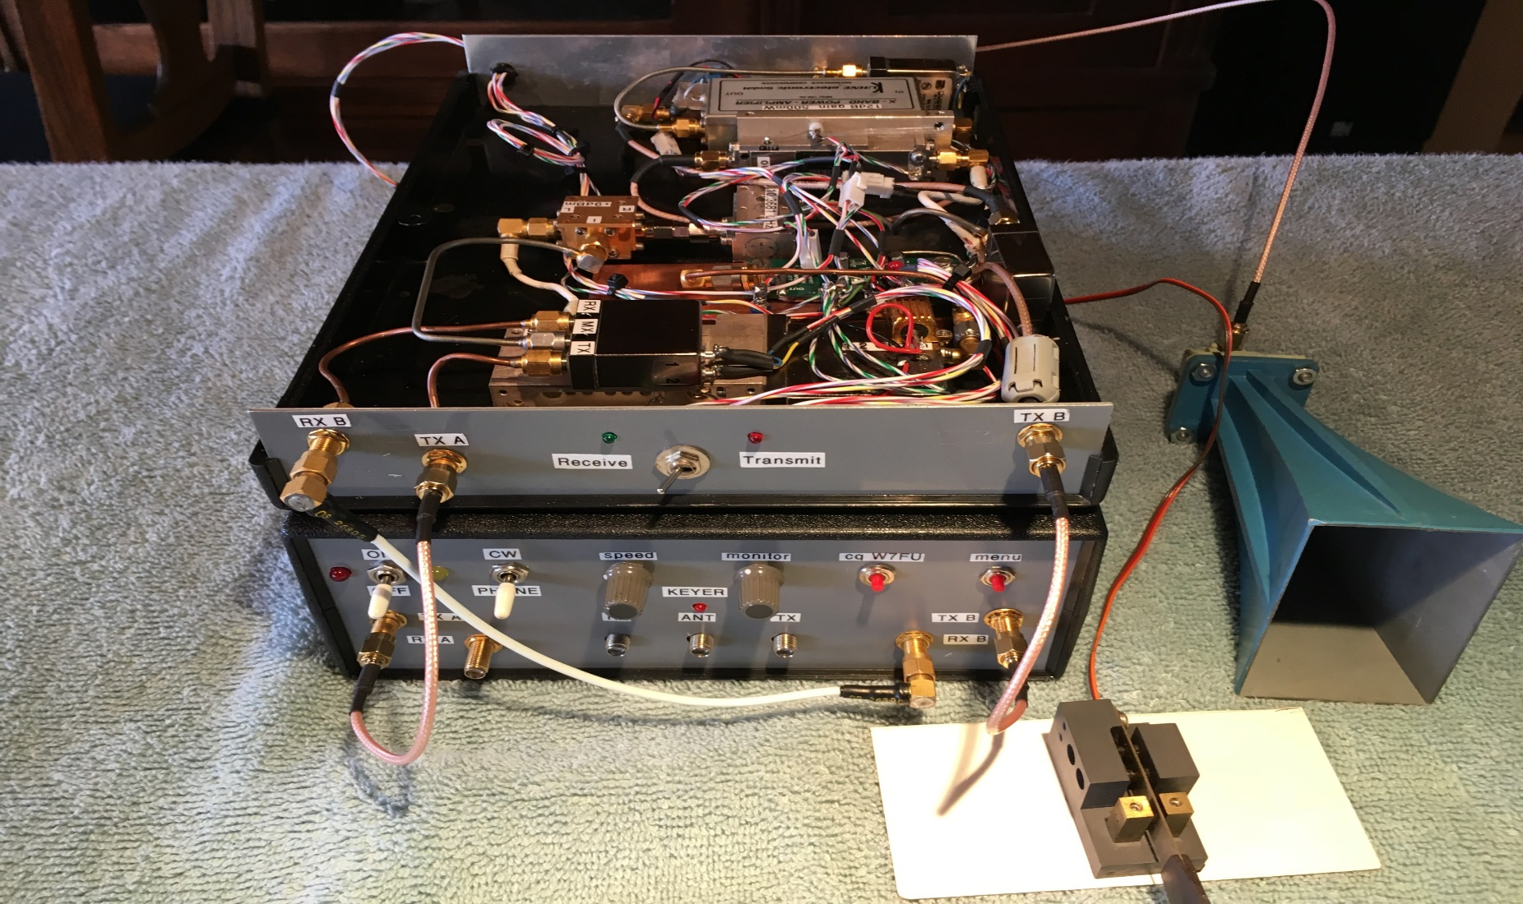
10 GHz SDR Transverter v.1

Slide 36
10 GHz Transverter Tune-up

Slide 37
10 GHz Transverter v.2: Integrated SDR IF and LO
Dual Transceiver SDR: Ettus B210
plus
Mini-Circuits SIM-153+ mixer
IF: 5.1881 GHz
LO: 5.1800 GHz
RF: 10.3681 GHz

Slide 38
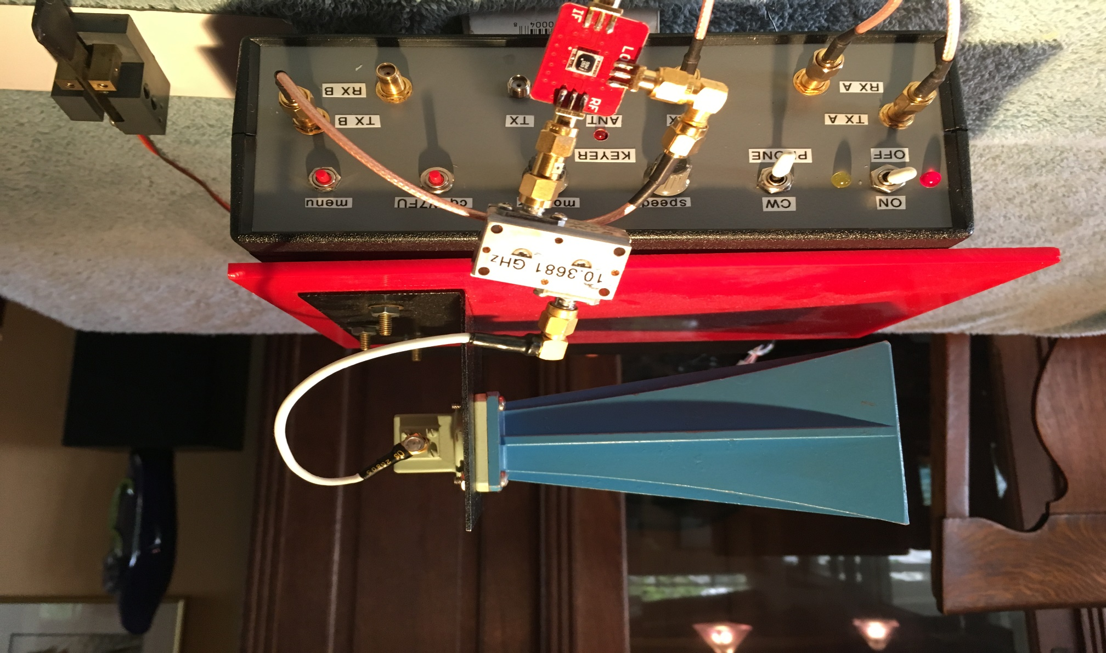
10 GHz SDR Transverter v.2

Slide 39
In Conclusion
I hope that you are stimulated by the possibilities
Thanks to Ray, W7GLF for his support on getting this equipment on the air
Thanks to the MUD 2017 organizers for the opportunity to present this material

Slide 40
Down the Slippery Slope…
More information about DSP and SDR
www.w7fu.com

Slide 41
Additional Questions ?
Hardware ?
Software ?
Other related topics ?

