Slide 1
VHF - UHF - Microwave SDR Transceiver on the air
John Petrich, W7FU
ARRL NW Division Convention
SEA-PAC 2017
June 3, 2017

Slide 2
Presentation Goals
Discover what is “under the hood” of a VHF SDR (or any SDR)
Learn “how to” build a practical VHF SDR - with photos
Address the question: “Do SDR’s have a place in VHF communications?”

Slide 3
VHF - UHF SDR Home Station

Slide 4
Microwave SDR Rover Station

Slide 5
Dirty Little Secret
“These same principles apply to any
SDR station HF to Microwave”
All SDRs need an RF interface to the amplifiers and antenna
All SDRs need peripheral devices to control the radio and station

Slide 6
Direct Sampling HF SDR
HF Antenna
A/D Converter
(Baseband)
FPGA DSP
signal
data
D/A Converter
Panadapter
Computer DSP
data
data
Audio
Baseband
Analog
Data

Slide 7
Direct Conversion VHF SDR
VHF Antenna
Mixer RFIC
A/D Converter
(Baseband)
signal
signal
D/A
Converter
Computer
DSP
FPGA
DSP
data
data
Etc..
Baseband
Analog
Data

Slide 8
What’s under the hood?
VHF / Microwave any-mode
SDR Transceiver
Direct conversion between RF and digital baseband
Single board solution with open source
DSP software

Slide 9
SDR Description
Hardware
Ettus Research B210 SDR dual transceiver
single board solution (6” x 4”) or (3.25” x 2”)
State of the art RF & baseband performance
TX RF output > +5 dBm, RX ~2+ dB NF
Software DSP
GNU Radio open source software DSP library
Linux, Windows OS platform
Graphical DSP authoring

Slide 10
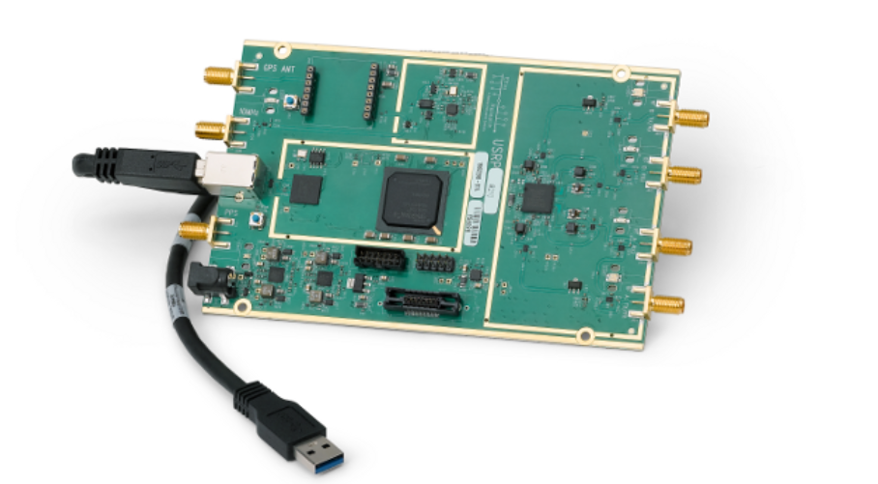
Advanced SDR Hardware
Ettus USRP B210 SDR Dual Transceiver

Slide 11
‘Advanced’ DSP Software
GNU Radio
Open source DSP library: (Linux, Windows, OSX, OS)
Graphical DSP authoring simplified
Optimized for ‘real time’ signal processing
(VOLK, C++ API)
Supports transmit and receive DSP

Slide 12
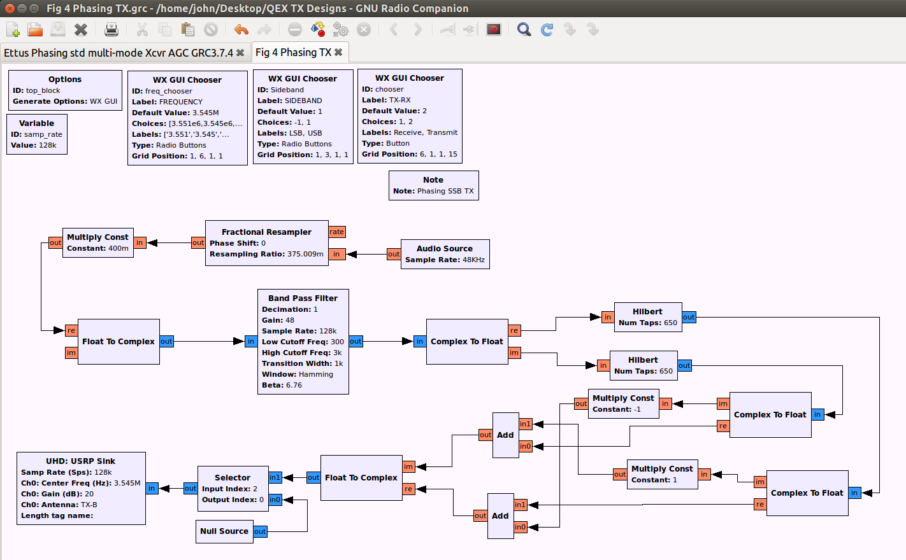
GNU Radio DSP Flow Graph
SSB Phasing Transmitter DSP

Slide 13
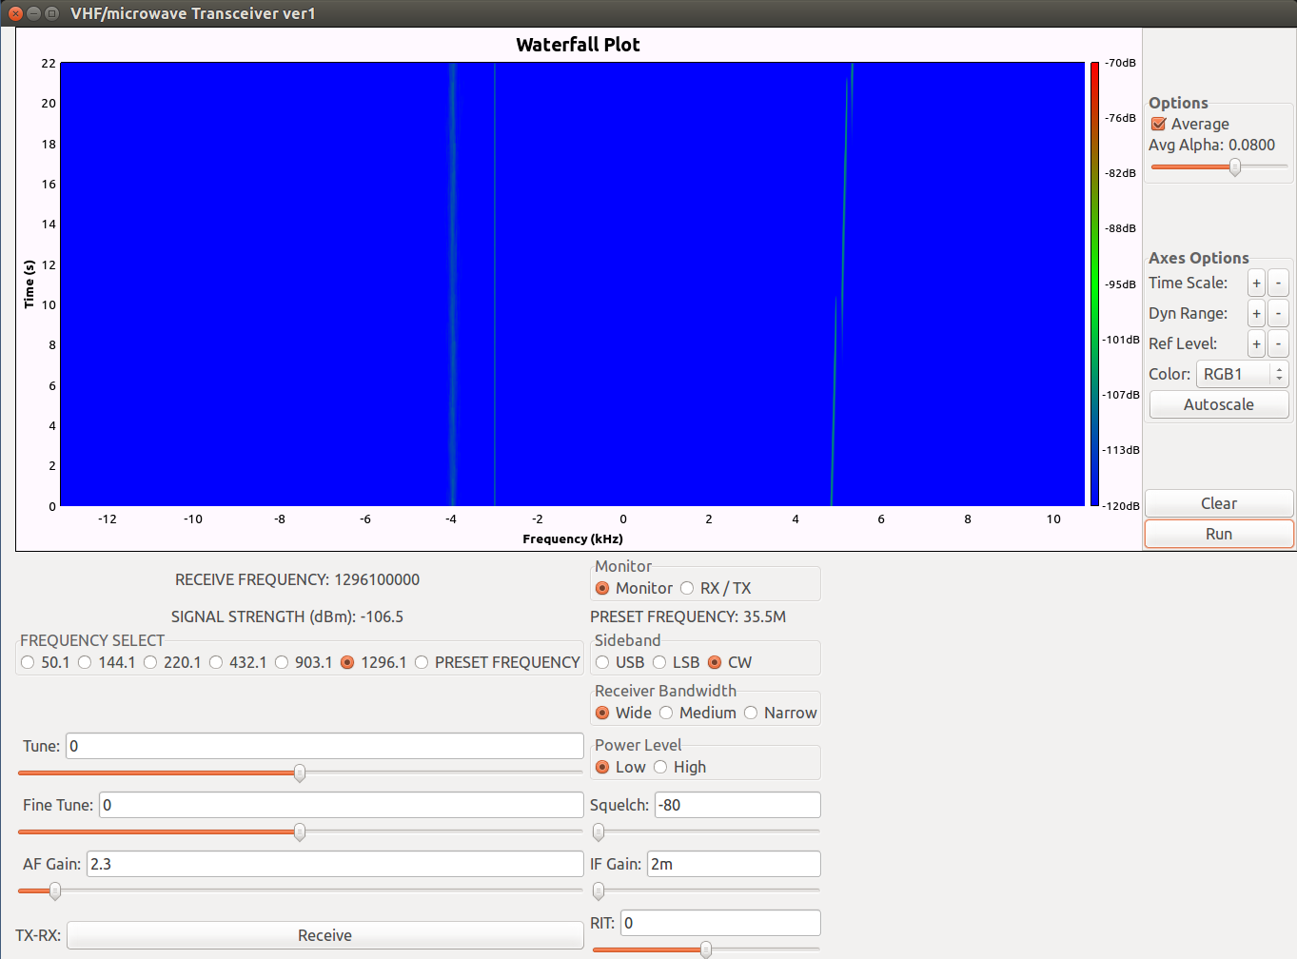
GNU Radio DSP GUI

Slide 14
Performance Measures
Transmitter Spurious Output
and Harmonics

Slide 15
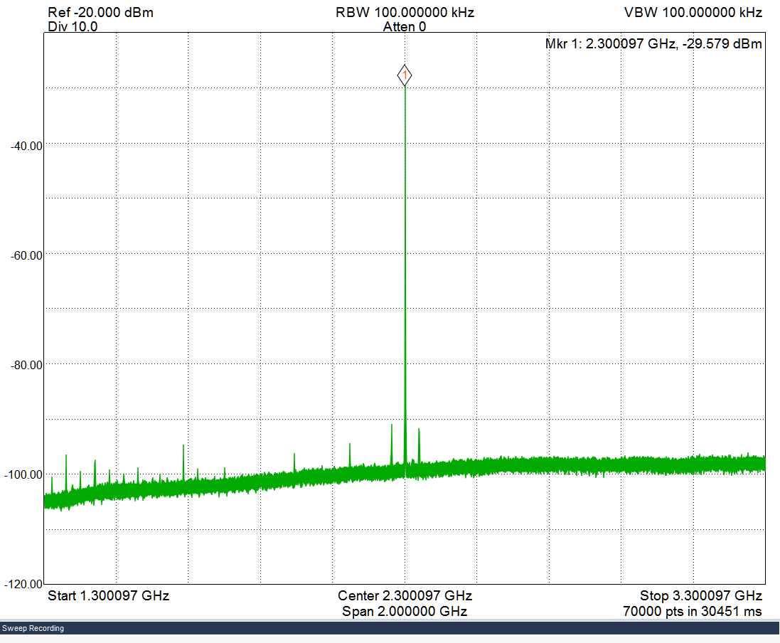
Microwave Spectral Purity
Wideband Transmit Spectrum @ 2.3 GHz

Slide 16
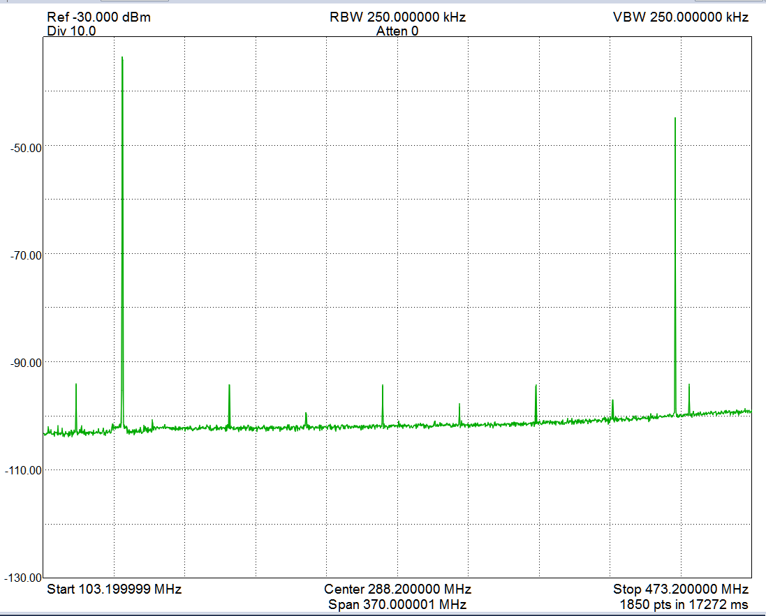
VHF Harmonic Analysis
Harmonic Analysis @ 144 MHz (typical)

Slide 17
“How to”: VHF – UHF - Microwave SDR
What parts are involved?
How it is done?
What does a VHF to microwave SDR actually look like?

Slide 18
SDR Transceiver

Slide 19
SDR RF Interface

Slide 20
SDR Peripherals

Slide 21
Band Specific Power Amplifiers

Slide 22
Band Specific Power Amplifiers

Slide 23
VHF/Microwave SDR Station
Conceptual model in four parts:
Broadband, direct conversion,Transceiver
2) Broadband RF Interface
3) Band specific Power Amplifiers, antennas
4) SDR Peripherals: transceiver system
control

Slide 24
SDR RF ‘Interface’
The RF Interface links the SDR with the rest of the RF system – antennas, amplifiers
Receiver input protection relay with termination, RFI filter for FM Broadcast
Low level transmit amplifier, T/R relay

Slide 25
SDR ‘Peripherals’
The SDR Peripherals link all the SDR transceiver and rig control functions:
OCXO
Keying circuits
Memory keyer
PTT and amplifier control
T/R relay– sequencer
DC power distribution system

Slide 26
All put together: Microwave SDR Rover Station

Slide 27
Bend, OR - Rover QSO

Slide 28
SDR: The New Normal?
Near ideal signal processing ability: ‘digital determinism’ – high performance
Supports all available amateur radio modulations and all VHF/UHF/lower Microwave frequencies -- - wide design flexibility
Integrates well with existing RF systems – simplifies system design
Size and weight attractive compared to
analog counterparts

Slide 29
Typical Analog Ham VHF System
High performance HF transceiver
Outboard Linear Up-converter(s) per band
Custom per band RF ‘interface’
HF
Transceiver Transceiver
Linear
Up-converter
Power Amplifier LNA Tx/Rx relay

Slide 30
Advanced SDR Ham VHF Radio System
High performance direct conversion SDR broadband transceiver
Custom per band RF ‘interface’
VHF/UHF SDR Transceiver
Power Amplifier
LNA Tx / Rx relay

Slide 31
In Conclusion
I want to thank Barry Hansen, K7BWH,
Phil Horkin, AG7GY, Mariana Varotto, WA7EE
For their generous assistance with this project
Thanks also to the ARRL for the opportunity to present this project

Slide 32
Down the Slippery Slope…
More information about DSP and SDR
www.w7fu.com

Slide 33
Additional Questions ?
Hardware ?
Software ?
Other related topics ?

