Slide 1
Using GRC to Build Radios
Kick Start: help the novice to use the flow graph in GNU Radio
John Petrich, W7FU
https://w7fu.com/make-the-flow-graph-work-for-you-talk-ham-radio-january-16-2021/

Slide 2
Major Topics
Getting started with GRC
Basic flow graph workspace organization
Flow graph details
Data flow problem solving
Practical odds and ends for real radios
Group discussion

Slide 3
Getting Started with GNU Radio
How to install GNU Radio
https://wiki.gnuradio.org/index.php/InstallingGR
Guided Tutorials
https://www.youtube.com/watch?v=N9SLAnGlGQs&list=PL618122BD66C8B3C4
(novice flowgraph techniques, an oldie but goodie)
https://wiki.gnuradio.org/index.php/Tutorials
(sophisticated and advanced techniques)

Slide 4
Workspace Organization Why Important?
Promotes an understanding of signal processing logic
Makes flow graph modifications easier
Facilitates trouble shooting and problem solving
Reduces risk of workspace mistakes

Slide 5
Workspace Organization

Slide 6
Flow Graph Details
Options or ‘top block’
Note blocks
Block rotation
Virtual Sources and Sinks
Samp_rate logic and gain distribution
Nested Python commands to control multiple functions

Slide 7
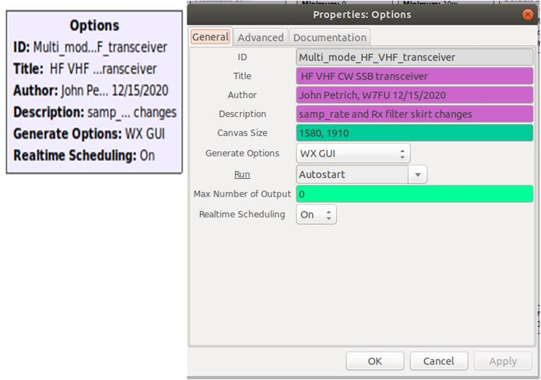
Options Block or ‘top block’

Slide 8
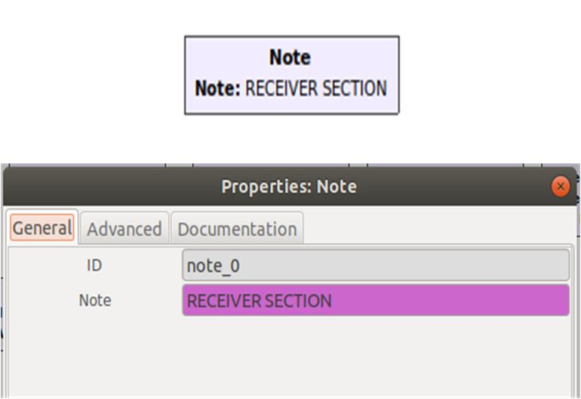
Note Blocks
Keep track of your thinking

Slide 9
Block Rotation

Slide 10
Notes and Virtual Sources and Sinks

Slide 11
Samp_rate Logic and Gain Distribution

Slide 12
Nested Python Commands Control Multiple Parameters

Slide 13
Nested Python Commands Control Multiple Parameters

Slide 14
Nested Python Commands Control Multiple Parameters

Slide 15
Flow Graph Problem Solving
Source and Sink not in your DSP library
Console data interpretation
Version and subversion problems
Signal tracing
Fractional resampler - ‘U’ and ‘aU’ interruptions
Bypass block option
Undo button on task bar

Slide 16
Source and Sink Drivers not in DSP Library
Solution: Download and install driver for your hardware
Pluto SDR
Https://wiki.gnuradio.org/index.php/PlutoSDR_Source
Lime SDR
https://medium.com/bugbountywriteup/limesdr-setup-with-gnuradio-gr-limesdr-and-gqrx-on-ubuntu-20-04-4b275176d7cd
HackRF
https://github.com/mossmann/hackrf/wiki/Getting-Started-with-HackRF-and-GNU-Radio

Slide 17
Console Data – GRC version + samp_rate error

Slide 18
Console Data – error corrected

Slide 19
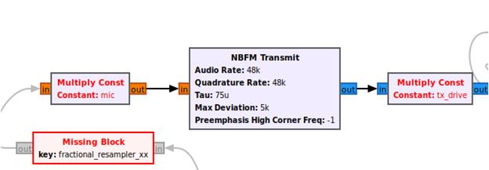
Version Problems: GRC v3.7 vs. v3.8
Version 3.7 flow graphs will not run on a Version 3.8 installation:
a blank workspace
Version 3.8 flow graphs will not run on a Version 3.7 installation:
missing blocks
Solution: Hand build flow graph: block by block, parameter by parameter from your DSP library. Not a Copy and Paste solution

Slide 20
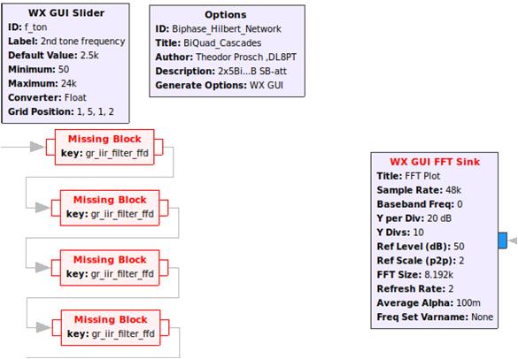
GRC v3.7 Subversion Problems: missing blocks
Solution: Replace missing blocks with blocks from your DSP library

Slide 21
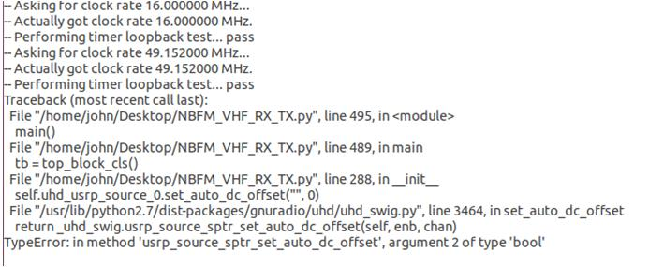
GRC v3.7 Subversion Problems: global failure
Solution: Try replacing Source and Sink blocks first. Otherwise, hand
Rebuild from your DSP library.

Slide 22
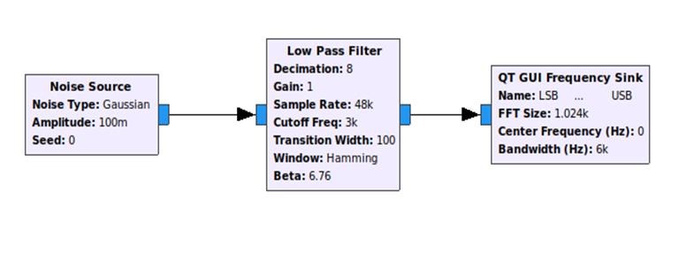
Signal Tracing and Stimulus Response Testing
Signal Tracing: Output to an instrumentation GUI widget, e.g.
FFT display to study data stream frequency components
Stimulus Response testing: Use a Signal Source or Noise Source
to study frequency response of filters, phase shifters, etc.

Slide 23
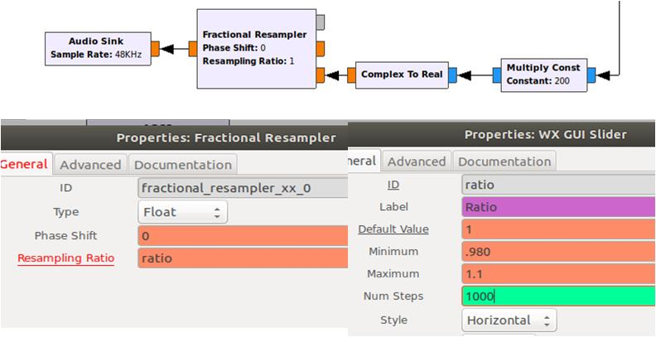
Fractional Resampler ‘U’ and ‘aU’ Interruptions
Adjust ‘Ratio’ GUI slider to reduce ‘U’ and ‘aU’ interruptions

Slide 24
Block ‘Bypass’ Option
A convenient means to functionally remove a block from a data stream.
<Right> click block and select <Bypass> from menu
Unbypassed block Bypassed block

Slide 25
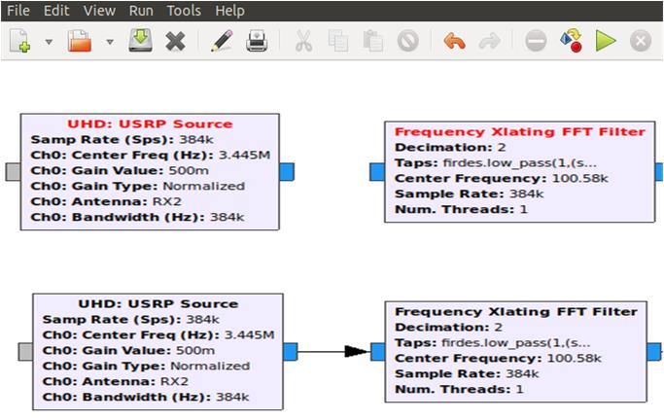
‘Undo’ Button on Task Bar
Easy way to undo workspace mistakes, especially common with congested flow graphs using computers with touch pads, small screens

Slide 26
Odds and Ends
Eliminate Receiver DC artifact
Selector switch
Analog TX/RX hardware logic control schematic
Software TX/RX control using duplex mode

Slide 27
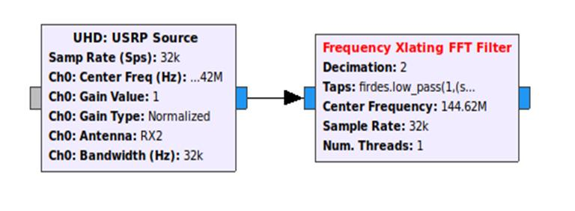
Eliminate Receiver DC Artifact
Solution: Offset Source center frequency and Freq Xlating filter center frequencies by the same amount in opposite directions, e.g. +/- 100e3 Hz

Slide 28
Eliminate Receiver DC Artifact Properties Boxes

Slide 29
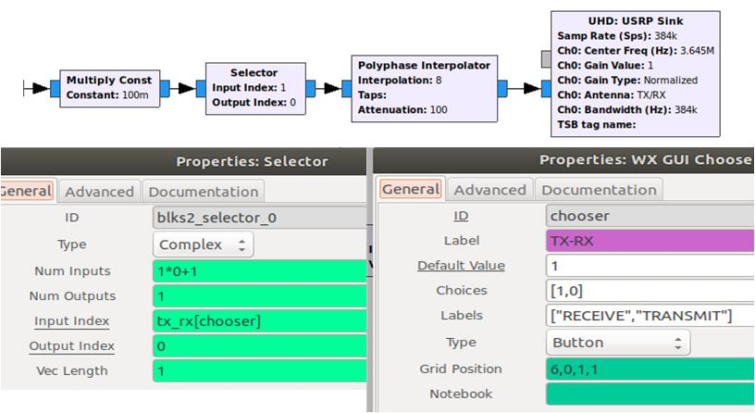
Selector Switch
Selector interrupts data flow and turns off Sink. Useful for hardware derived logic for TX/RX switching systems.

Slide 30
Analog TX/RX Hardware Control
Solution: Use a small amount of current from the SDR RX or TX LED
as a logic source. Use the current to drive a high gain transistor switch
array. The transistor switch then controls other system switches and
relays, i.e. PA’s, preamplifiers, antenna relays, etc.

Slide 31
Analog TX/RX Hardware Control Schematic Diagram

Slide 32
Software TX/RX Control: Duplex Mode
Solution: Use nested commands
Receive mode: The Source center frequency is selected for the desired operating frequency. The Sink center frequency is selected to “0” frequency. (or some out-of-bounds frequency)
Transmit mode: The Sink center frequency is selected for the desired operating frequency. The Source center frequency is selected to “0” frequency. (or some out-of-bounds frequency)

Slide 33
Software TX/RX Control: Duplex Mode

Slide 34
Group Discussion
What additional flow graph techniques do you want to share?
What are your current GRC projects or problems?

